Slide 1


Creating a culture of Quality Practice in the medical world

Slide 2
Abstract
An application that allows the general public to search for registered healthcare practitioners and facilities.
Notes:
In the Kenyan context sometimes the population takes it for granted that everyone in a white coat is a doctor and that is not true
You may have noticed that sign posts doting the landscape of a medical practitioner here, and another one there. But few Kenyans had ever discovered that in the medical sector not all that shines is gold.
number of high-profile cases of malpractice
including patients being molested, paralyzed and even killed by people pretending to be doctors - have come to light across the country.
As per Kenya Medical Practitioners, Pharmacists and Dentists Union (KMPPDU), 9 out of every 10 clinics are run by unqualified people.
Example of quark doctor.
Dr Mugo Warimu who raped patients when they went to his clinic.
NTV Investigates Dr.Fake; Kenya's doctors without degrees

Slide 3
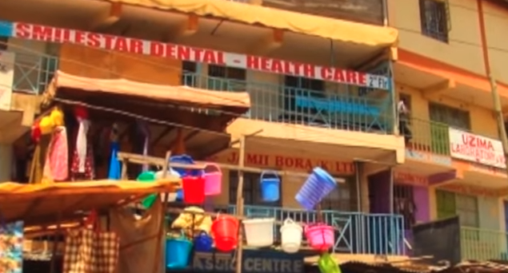
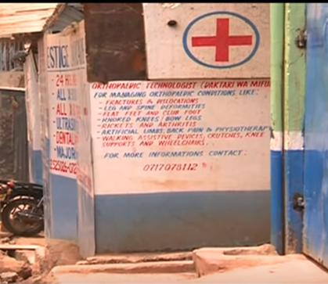
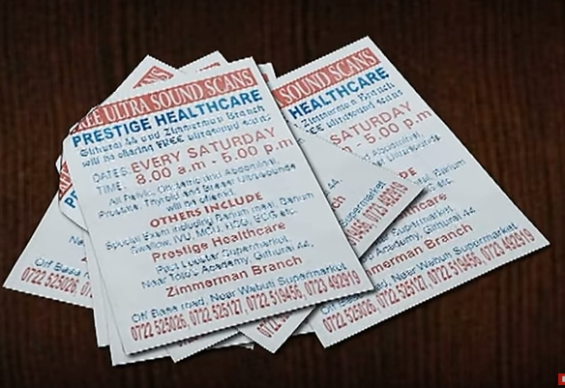
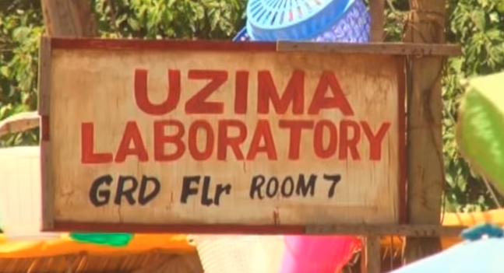
Background
Quark Doctors
“everyone in a white coat is a doctor and that is not true”
Unlicensed Health facilities
As per Kenya Medical Practitioners, Pharmacists and Dentists Union (KMPPDU): “9 out of every 10 clinics are unlicensed & run by unqualified people.”
Notes:
In the Kenyan context sometimes the population takes it for granted that everyone in a white coat is a doctor and that is not true
You may have noticed that sign posts doting the landscape of a medical practitioner here, and another one there. But few Kenyans had ever discovered that in the medical sector not all that shines is gold.
number of high-profile cases of malpractice
including patients being molested, paralyzed and even killed by people pretending to be doctors - have come to light across the country.
As per Kenya Medical Practitioners, Pharmacists and Dentists Union (KMPPDU), 9 out of every 10 clinics are run by unqualified people.
Example of quark doctor.
Dr Mugo Warimu who raped patients when they went to his clinic.
NTV Investigates Dr.Fake; Kenya's doctors without degrees

Slide 4

Problem
Kenyans are suffering as a result of
Quark Medical Practitioners & Malpractice
patients being molested, some paralyzed and even killed
Unlicensed Health Facilities
Example Uzima Laboratories & Prestige clinic
A Culture of Quality Practice within Medicine needs to be nurtured.
Notes:
In the Kenyan context sometimes the population takes it for granted that everyone in a white coat is a doctor and that is not true
number of high-profile cases of malpractice - including patients being molested, paralyzed and even killed by people pretending to be doctors - have come to light across the country.

Slide 5
Solution to the Problem
Use Mobile Technology (iOS) to create a platform for the general public to:
Search for Registered Medical Practitioners and health care facilities
Report any malpractice, unregistered healthcare practitioners and unlicensed healthcare facilities.

Slide 6




Architecture
KMPD Board
Nursing Council Board

Slide 7
Thanks ☺

